Slide 1
JAYPEE UNIVERSITY OF ENGINEERING
AND TECHNOLOGY
BATCH 2020-2024
MINOR PROJECT PRESENTATION - III
Project Name: JUET Navigation System
Project Mentor
Project Members
Pratishtha Singh(201B194)
Prabal Sharma(201B180)
Dr. Prateek Pandey
Project No.
26

Slide 2
Progress till Presentation II
We imported the Floorplan of our Hostel and created the added game objects for indicating the user’s location and destination position.
We further added the Navmesh component in our project which would calculate the total walkable path which would help in defining the shortest path to reach the destination.
We then tested the application after doing certain changes in the project environment and it run successfully.

Slide 3
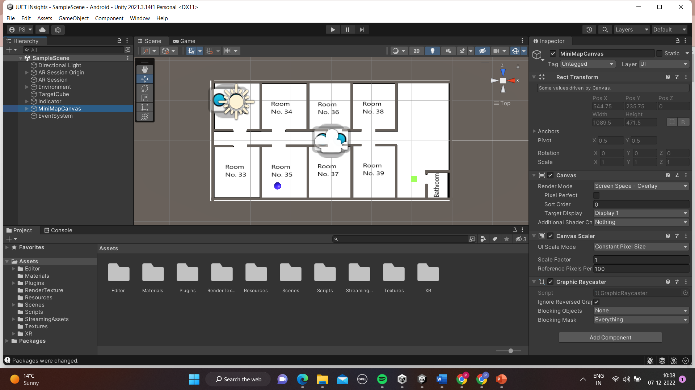

Slide 4
Further add-ons to the Project -
Adding multiple target objects on the floor plan.
Altering the canvas,which displays the application view,and add certain things to make it more interactive,which includes -
a) Adding the toggle line visibility button.
b)Adding the Drop-down menu button.
Adding some scripts to declare and instantiate the variables for the addons which we have made in the application in order to make in working.

Slide 5
Text Mesh Pro -
Text Mesh Pro provides Improved Control over text formatting and layout with features like character, word, line and paragraph spacing, kerning, justified text, Links, over 30 Rich Text Tags available, support for Multi Font & Sprites, Custom Styles and more.
This package is to be downloaded and included in our project,for better interaction with the buttons in our application

Slide 6
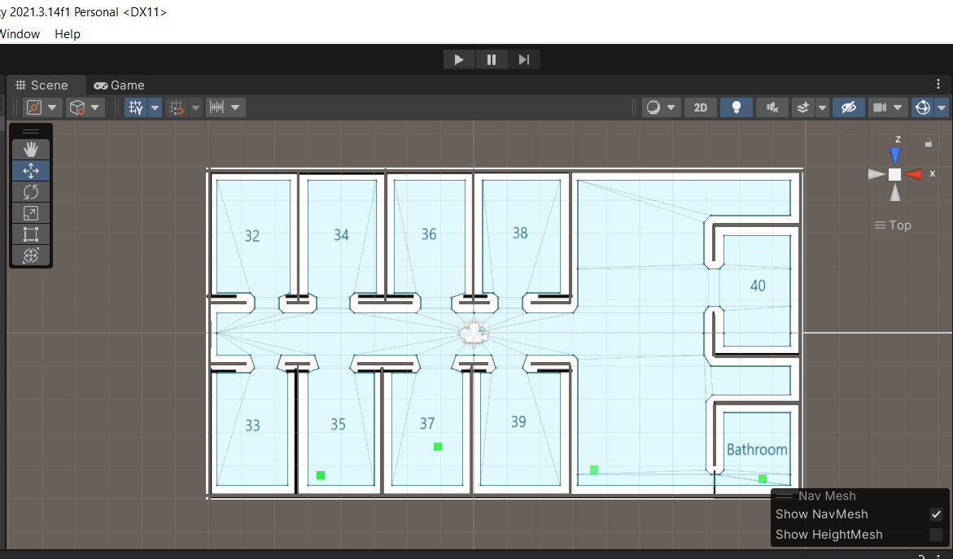
Multiple Targets -
Creating multiple targets to represent different destinations,and naming them according to their positions on the floor plan.
Updating the NavMesh component in order to get the updated walkable path,which would be necessary for the navigation.

Slide 7
Toggle Line Visibility Button -
Adding the toggle line visibility button,in order to toggle line rendered by the line renderer which shows the path towards the destination.
Adjusting its size and positioning and editing the button text which would get displayed in the application.

Slide 8
Drop -Down Menu button -
Adding the Drop-down text mesh pro in order to add the drop down menu in the application,which would have different destination reachable in the map.
Adjusting its size within the canvas and adding the different location in the drop down menu in inspector window along with their targets included.

Slide 9
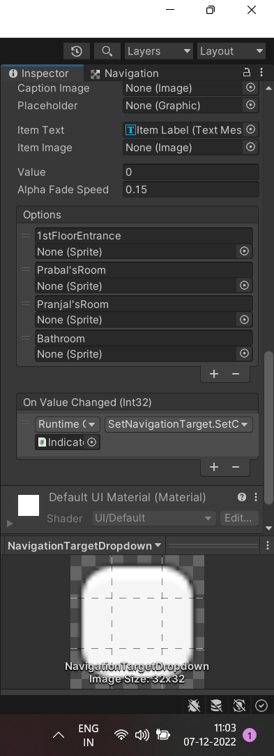
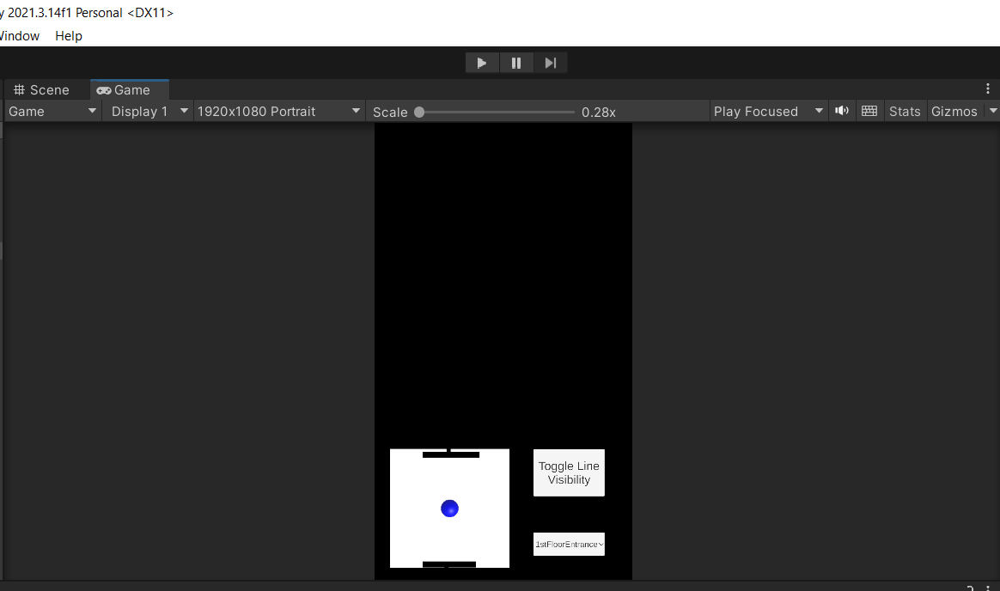

Slide 10
Scripts -
Scripts is written in two files namely Target.cs and SetNavigationTarget.cs in C# language.
Variables are declared and instantiated for NavigationTargetDropButton and TargetObjects and writing function for the working of the application.

Slide 11
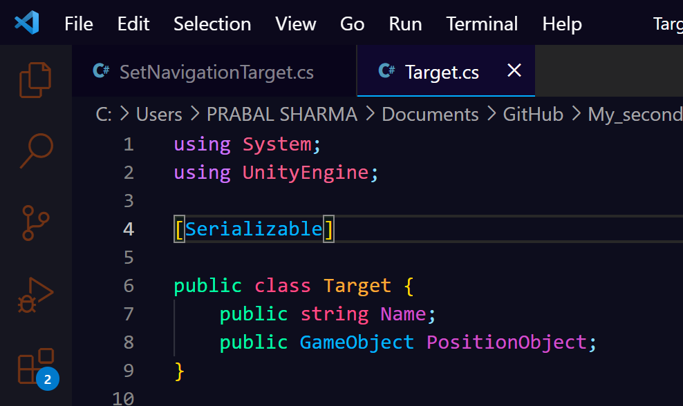
Target.cs Script -
This script is written for the serializability of the application. So,that everything can be displayed in the inspector window and also in the game window.

Slide 12
SetNavigationTarget.cs Script -
This script is specifically written for the proper working of the application.
Variables for the button,target objects and line toggle visibility is instantiated.
Functions start() for calculating the path from source to the destination is written,and Update() function for updating the path from the current position,if the current position is not origin.
Toggle line visibility function is created to set the line visibility of the line to true after the toggle line visibility is clicked.

Slide 13
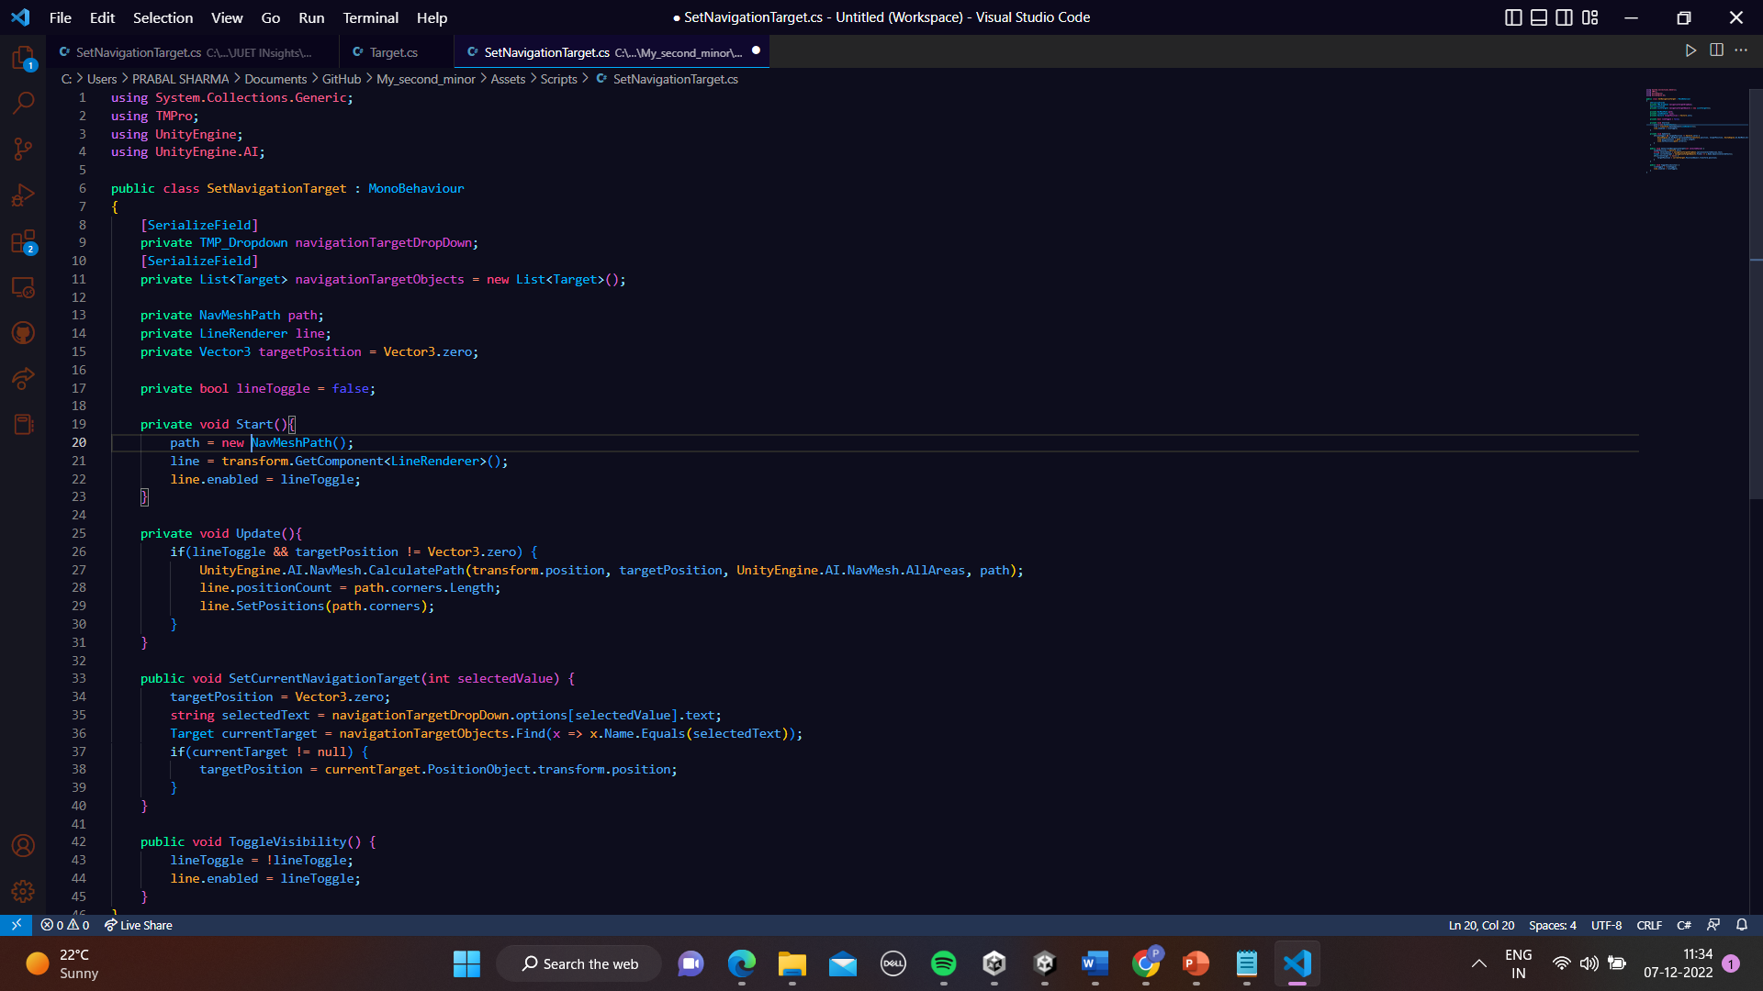

Slide 14
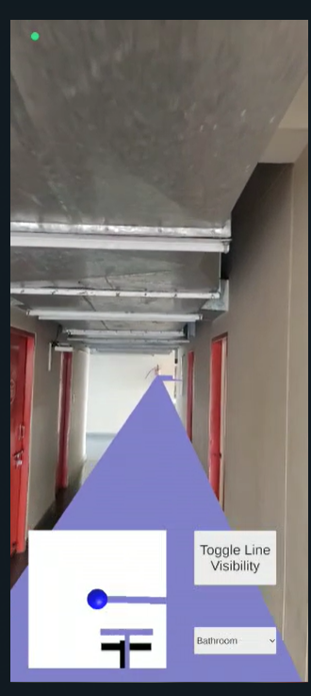
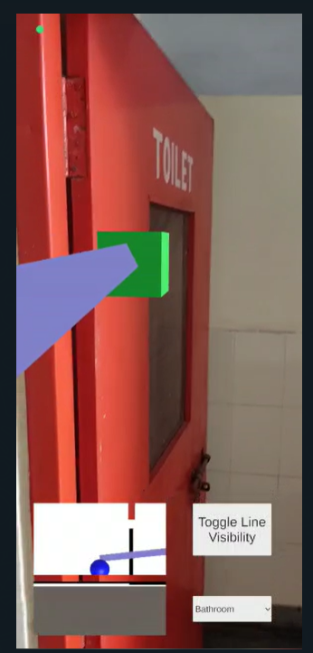
Conclusion -
After installing the apk of the application,we tried to test it,by selecting Bathroom from the DropDown menu and clicking the toggle line visibility button,in order to get the path,and we successfully were able to reach the destination.

Slide 15
Updates of Application
Adding the Qr Code recentering so that of user is not at the origin he can scan it,inoder to set its current position as start.
Adding the marker based positioning in the application.

Slide 16
Thank You !

